Slide 1


Public Health Nursing Learning Lab
July 23, 2025

Slide 2


Welcome!
Staff and Facilitator Introductions
Who’s Here Today?

Slide 3
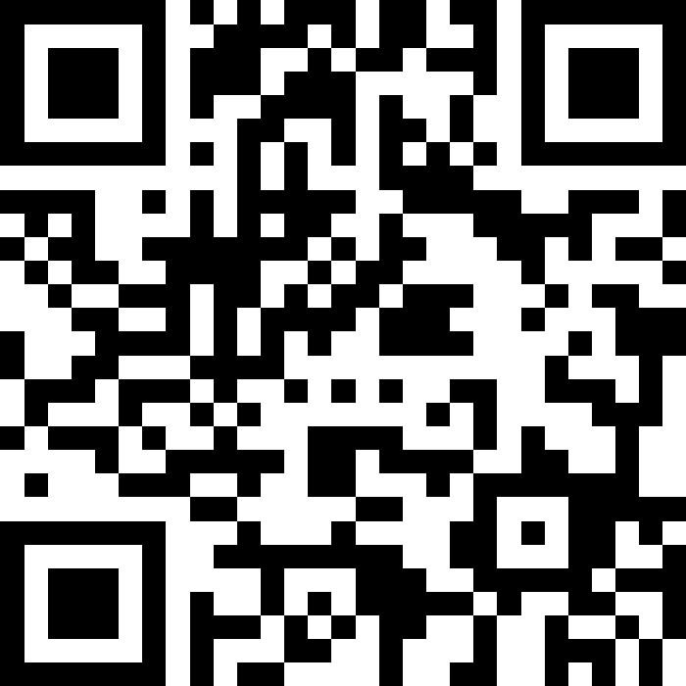
Slido Poll

Slide 4

PHN Learning Lab: Why Now?
Public Health Improvement Initiative (PHIG)
RWJF Future of Public Health Nursing
Continuing Commitment to Strengthen the Field

Slide 5
PHN Learning Lab: What Can You Expect?
Five live, online sessions
  July 23 - Understanding the Landscape: The Role and Impact of Public Health Nurses Today
  August 27 – Evidence-Based Recruitment and Retention Strategies in Public Health Nursing
  September 24 – Public Health Nursing Residency Programs and Leadership Pathways
  October 22 – Leveraging Partnerships to Strengthen the Public Health Nursing Workforce
  November 19 – Public Health Nursing Workforce Culture

Slide 6

PHN Learning Lab Library
Hosted on APHN Website, Accessible from Home Page
Session Content, PHN Workforce Publications and Other Resources, Stories from the Field
https://www.phnurse.org/

Slide 7

PHN Learning Lab: What Can You Expect?
PHN Learning Lab Library
APHN Website
    https://www.phnurse.org/

Slide 8
PHN Learning Lab: What Comes Next?
Continuous Learning
Shared Strategies to Advance Public Health Nursing

Slide 9

Research on the PHN Workforce: Roles, Trends, Impact and Current Questions
Paula Kett, PhD, MPH, RN, IBCLC

Slide 10
Peer-to-Peer Dialogue
Adapting to Changing PHN Roles and Responsibilities

Slide 11
See you on August 27!
PHN Recruitment and Retention Issues, Opportunities and Strategies

