Slide 1



Research on the PHN Workforce:
Roles, Trends, Impact and Current Questions
Paula Kett
University of Washington
Public Health Nursing Learning Lab
July 23, 2025

Slide 2
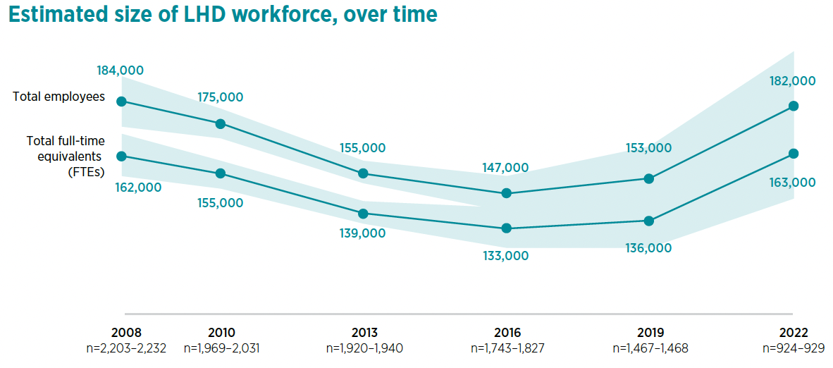
Local Health Department (LHD) Workforce Changes
(NACCHO Profile of Local Health Departments, (2022) NACCHO_2022_Profile_final.pdf )
Notes:
To give a bit of context....here's a slide from NACCHO regarding changes in the LOCAL PH WF over time.
You'll see (perhaps no surprise) that the numbers have been going way down over the years, until mostly during the pandemic.
So by 2022 – it DOES show PH staff OVERALL increasing
(...and now, btw, they're dropping again)

Slide 3
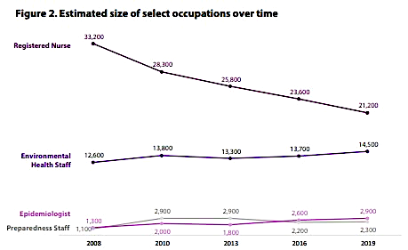
LHD Workforce Changes by Occupation
(NACCHO Profile of Local Health Departments, (2019) NACCHO_2019_Profile_final.pdf )
Notes:
This slide only goes until 2019, but breaks up these WF changes by discipline
And in this graph really see what has generally been DRIVING this overall WF decline
And, frankly, the 2022 data (now shown here) would have RNs STILL decreasing – down to 20,400 ! ...even as the WF overall was increasing
OPTIONAL:
Twenty-five percent of LHD top executives are age 60 or older,
compared with 16 percent in this age group in 2005.
Most top executives are in their forties or fifties, although the
percentage in this age group decreased from 85 percent in 2005 to 75 percent in 2013.

Slide 4







Who are they? Where are they?
Why do they matter?
What do THEY need?
What do they do?
How many do we need?
Notes:
Today, we are discussing the “state of the science” around PHNs – to give a little bit of insight to HOW we need to go about building the evidence – what do we know, what do we still need to better understand.
We often get asked if we can provide others with data that show that “PHNs matter” – and the reality is, we DO have some evidence that demonstrates this BUT to answer that question WELL, there is a host of other data and research that is needed and we wanted to lay that out a bit for you today.
Who are they – meaning demographics, education, background
Where are they – distribution, settings, rural/urban location
What do they do – functions and activities, specialties
What do THEY need – training, support, recruitment, retention
The questions we get asked all the time:
What is their value – e.g. are outcomes better when they are around?? The question is really getting at health outcomes, but we also are interested in things like organizational and workforce outcomes too.
How many do we need? (and really, how many are there???)

Slide 5

Who/Where are PHNs?
Size
  29,387 PH/CH RN FTEs in local and state health departments³
  ~3.7% of the overall RN workforce – including those in public health, school health, corrections⁴
Demographics
  Largely female, White⁴
  Aging - over 1/3rd above 51yo^{1,4} ; 15% 60+³
  Most with Bachelors as highest education⁴
  More diversity in federal PHN workforce → 45.5% White, 28.5% Black; 59.1% Masters or higher
Where are they?
  ~ ¼ in rural areas⁵
  North Dakota, Minnesota, Alaska – highest % of PHNs of all the states⁴
Notes:
So first....Who/Where are PHNs?
...and in all of these introductory slides we're pointing to EXISTING (and sometimes very NEW) PHN-related research that we hope might be useful to you! ...you'll see a reference list at the end that you'll be able to acces and w/ many of the papers as Open Access (that you'l be able to go to w/o special library privileges)
Size
Decreasing over time
Most recently we were a part of an Enumeration effort that calculated 29,387 PH/CH RN FTEs in local health departments³ - the last enumeration prior to this, done in 2012, estimated closer to 34000.
When looking at national nursing workforce data, we found that if measuring “conservatively” – PHN governmental health workforce amounts to approx. 1.8% of RN workforce
...broadening this out to looking at where RNs might be working in PHN-related roles – including those in public health, school health, corrections^{4—}we found they made up only ~3.7% of the overall RN WF nationally
Demographics
Majorly female, White^{4 –} approx. 90% and 80%
Aging workforce - over 1/3rd above 51yo^{1,4} ; 15% 60+³
Most report Bachelors as highest level of education^{4 →} find that this has increased over time
We were also fortunate to be able to do some research w/ Dr. Aisha Brooks (today's closing speaker) regarding the USPHS
More diversity in specific PHN workforce groups – USPHS → 45.5% White, 28.5% Black
59.1% Masters or higher
Where are they?
Approximately ¼ work in rural areas⁵
North Dakota, Minnesota, Alaska – highest proportions of PHNs out of all the states⁴

Slide 6



What do PHNs do?
Roles
  LHD directors, nursing directors, frontline PHNs, consultants, researchers, educators, advance practice nurses, policy.^{1,5}
Functions
  Individual: Fill existing gaps, care coordination, clinical interventions.^{5,6}
  Systems: Cross-sector collaboration, coalition building, engage in strategizing to address population health need
  Leadership roles: setting strategic direction, partnership-building, relationships in the community, avenues for community feedback⁷
Specialization
  In PH surveys, most working in MCH, communicable disease, clinical services, and school health.⁸
  In nursing surveys, most specializing in school health, PH or corrections.⁴
Notes:
We've also been trying to better understand the PHN landscape, by going BEYOND 'where' they work (SETTING) and, instead, by roles and functions. So we are more likely to be uncovering PHNs that are really doing PHN-type work.
Functions:
“who needs to do what where” across sectors
Specialization:
In PH surveys, most report working in MCH, communicable disease, clinical services, and school health.⁸
In NURSING surveys, most report specializing in school health, PH or working in correctional health.⁴

Slide 7

Why do PHNs matter?
Distinct skills
  Building trust and connection in the community^{9,10,15}
  Broad knowledge base of populations, communities¹¹
  Ability to see and act on the big picture¹⁵
  Nurses in PH leadership
    Emphasizing SDOH in policies¹²
    “managing up” ; strategic in their approach to leadership⁷
  Skills important for emergency preparedness and response⁸
  Climate justice work¹⁴
PHN Leaders - support a competent PH workforce^{7,8}
Health outcomes better in counties where nurses hold PH leadership positions¹³
Notes:
This is both about what PHNs bring to the PH and nursing workforce overall and their impact on the community’s health
We have citations here to studies that demonstrate PHNs':
Distinct skills in areas such as:
Nurses as bridgers^{9,10}
Broad knowledge base of populations, communities¹¹
Nurses in PH leadership - Emphasizing SDOH in policies¹²
Systems perspective; “managing up” ; strategic in their approach to leadership⁷
Skills important for emergency preparedness and response⁸
Climate justice work (LeClair)
Support a competent PH workforce^{7,8}
Health outcomes better in counties where nurses hold PH leadership positions¹³

Slide 8

What do PHNs need?
Stronger training and education^{1,8}
Access to professional development^{5,14}
Training for using data to inform practice; policy development⁸
Education of PH leadership about the PHN role¹⁵
Opportunities to practice to top of scope¹⁵

Slide 9

How many PHNs do we need?
?
Notes:
This is a sticky question – and really something that is specific to each community. However, something I’ll talk about in a moment is that we are trying to address this somewhat with regard to NEED – a colleague, Dr. Casey Balio, recently developed the PHN Need Index using a whole host of county-level measures which might indicate “need for” a PHN – health outcomes, sociodemographics, resource availability in the county, etc… and looked at does the supply of PHNs in the country match identified need? And by and large – no. So we know there is likely a mismatch going on…which is not necessarily a unique issue to PHNs, but is something we need to dig into further – i.e. WHY does it matter? I’ll talk about that in a minute.

Slide 10
Ongoing questions
Defining the PHN role
What does it look like when PHNs are working at the top of their practice?
Training
How to help PHNs work to their highest scope of practice?
Measurement
How to best 'identify' PHNs in terms of their practice?
How many are needed? Where? For what?
Impact
Do they bring a return on investment?
How to communicate their impact?
Educating
Are there enough PHNs being produced?
Recruitment and Retention
How can we attract more nurses to the field?
What types of factors are associated with retaining PHNs? With turnover of PHNs?
Notes:
As you can see, we are making good progress (& a lot of this w/ very recent research) with building the evidence for the PHN WF, BUT there is still a ways to go in really comprehensively understanding this workforce AND in really helping to grow, support, and sustain this WF.
This list of questions isn’t comprehensive, but is a snapshot
And it isn’t just about the research – we really need partners in policy, education, AND practice to help with identifying the right questions, gathering/understanding the data, and applying this knowledge
And we have to look at data, at PHNs in many different ways, be creative in our approaches, to try and answer these questions….PHNs are a big part of the PH workforce, but also important to help distinguish them in the RN workforce, because support and solutions can come from many places

Slide 11
PHNs compared to other RNs → what do we know?
PHNs in the National Sample Survey of Registered Nurses
Drop among PHNs in governmental PH settings over time (50% to 34%); school health more stable
Training gaps → emergency preparedness; caring for populations with substance use disorders
Slower increase in salary– on average ~$19K less annually
Less likely to report being able to practice to top of scope
Compared to other RNs
Many select “other” when asked about activities
More likely to have Master’s prior to RN and non-nursing Master’s
Notes:
Important to identify these differences → range of implications such as with respect to measurement – i.e. questions asked on a nursing workforce surveys; for where additional attention may be needed for recruitment and retention or leadership education; for where to address training gaps

Slide 12

Measuring impact - when need doesn’t match supply
Upcoming study
Using PHN Need Index - examine differences in a range of health outcomes in counties which have a match or mismatch of PHN supply to PHN need
Follow on to previous study which found better health outcomes (and reduced disparities) in counties where nurse was LHD director

Slide 13
Questions for you
In thinking about this research that has been done, what do you think this could mean for public health nursing practice and/or public health leadership in general?
What questions does this information prompt?
What further research is needed? What is still missing?

Slide 14

More details and information: https://familymedicine.uw.edu/chws/
Contact: Paula Kett, pmk@uw.edu
Follow us on Facebook, LinkedIn and Twitter @uwchws

Slide 15
References
Beck AJ, Boulton ML. The public health nurse workforce in U.S. state and local health departments, 2012. Public Health Rep. 2016;131(1):145-152. doi:10.1177/003335491613100121.
Pittman PPF, Park JP. Rebuilding Community-Based and Public Health Nursing in the Wake of COVID-19. Online J Issues Nurs. May 2021;26(2):1-10. doi: 10.3912/OJIN.Vol26No02Man07
Leider JP, Balio CP, Hogg-Graham R, et al. Enumeration 2024: What We Know and What We Wish We Knew About the Governmental Public Health Workforce in a COVID-19 Recovery Landscape. Am J Public Health. 2025;0(0):e1-e9. doi:10.2105/ajph.2024.307960
Bekemeier B, Kett PM, Whitman G, Chadwick K, Edmonds JK. Distribution and Specialties of Broadly Versus Narrowly Defined Public Health Nurses Working in Government Settings in the United States, 2022. Am J Public Health. 2025;115(4):536-545. doi:10.2105/ajph.2024.307950
Kett PM, Whitman G, Edmonds JK, et al. The demographics, training, and job functions of the United States Public Health Service Commissioned Corps nursing workforce. Nurs Outlook. 2025/05/01/ 2025;73(3):102385. doi:/10.1016/j.outlook.2025.102385
Edmonds JK, Campbell LA, Gilder RE. Public health nursing practice in the Affordable Care Act era: A national survey. Public Health Nurs. Jan 2017;34(1):50-58. doi:10.1111/phn.12286
Kett PM, Bekemeier B, Altman MR, Herting JR. “Not everybody approaches it that way”: Nurse-trained health department directors’ leadership strategies and skills in public health. Nurs Inq. 2022:e12487. doi:https://doi.org/10.1111/nin.12487
Kett PM, Shahrir S, Bekemeier B. Public Health Nurses’ Proficiencies and Training Needs in an Emergency Response: A Cross-Sectional Observational Study. J Public Health Manag Pract. 2024;30(3):354-366. doi:10.1097/phh.0000000000001888
Beck AM, Piontek AJ, Wiedenman EM, Gilbert A. Perceptions of COVID-19 mitigation strategies between rural and non-rural adults in the US: How public health nurses can fill the gap. Nursing Reports. 2022;12(1):188-197. doi:10.3390/nursrep12010019
Martsolf GR, Sloan J, Villarruel A, Mason D, Sullivan C. Promoting a culture of health through cross-sector collaborations. Health Promotion Practice. 2018;19(5):784-791. doi:10.1177/1524839918772284
Swider SM, Levin PF, Reising V. Evidence of public health nursing effectiveness: A realist review. Public Health Nurs. 2017;34(4):324-334. doi:10.1111/phn.12320
Kett PM, Bekemeier B, Herting JR, Altman MR. Advancing health equity: Organizational characteristics emphasized by health department nurse lead executives. Public Health Nurs. 2022;39:1308-1317. doi: https://doi.org/10.1111/phn.13109
Kett PM, Bekemeier B, Herting JR, Altman MR. Addressing health disparities: The health department nurse lead executive's relationship to improved community health. J Public Health Manag Pract. 2022;28(2):E566-E576. doi:10.1097/phh.0000000000001425
Leclair J, Dudek A, Zahner S. Climate Justice Strategies Implemented by Public Health Nurses and Their Community Partners. J Adv Nurs. 2024;doi:10.1111/jan.16598
Kett PM, Guenther GA, Shahrir S, Mohammed SA, Bekemeier B. Why Public Health Nurses Matter: Bringing Specialized Knowledge and Skills to Advancing Health Equity. Nurs Inq. Apr 2025;32(2):e70018. doi:10.1111/nin.70018

